Slide 1
The What & How of Safe Patient Handling
Lori Fredric
Lisa Bennett
Colorado ASSE Spring Professional Conference, 2016

Slide 2
What is OSHA Doing?
OSHA Memo: Inspection Guidance for Inpatient Healthcare Settings, June 25, 2015
All inspections will Include
MSDs relating to patient or resident handling
Workplace violence
Bloodborne pathogens
Tuberculosis
Slips, Trips & Falls
How do we get out there
Programmed Inspections
Complaints
Work-Related Injury and Illness Logs

Slide 3
What Does OSHA Want ? A Live Active Program
OSHA Safe Patient Handling Program Guidance
Management & Staff Involvement
Needs Assessment
Equipment
Education & Training
Evaluation
osha.gov/dsg/hospitals

Slide 4
What Is OSHA Going to Do
Inspection
Review records: programs, Injury and Illness logs, maybe present a medical access order
Interview employees
Watch employees
Outcomes
Citation
EHAL – follow up potential
Education Letter
Nothing

Slide 5
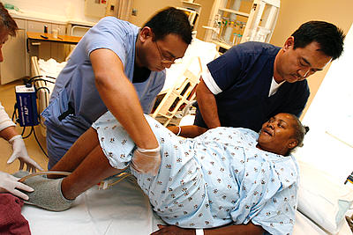
Lifting
Material Handling
Safe Patient Handling
Dynamic
Not ideal conditions
Partnering in a task

Slide 6
Interactive
Stability
Core Lock -
spinal protection
in worst-case
scenarios

Slide 7
Solutions: Don’t have to be medication and surgery
Activities for work practice controls
Warm Up (mobility)
Recovery activities during a shift, Corrective
Warm Down, stretching
Available on site resources – Can you designate some of their time for Employees?
PT - Athletic Training - Message Therapist
Education
Body, muscle balance, fascia
how to work with the tools
Empowerment, Authority

Slide 8
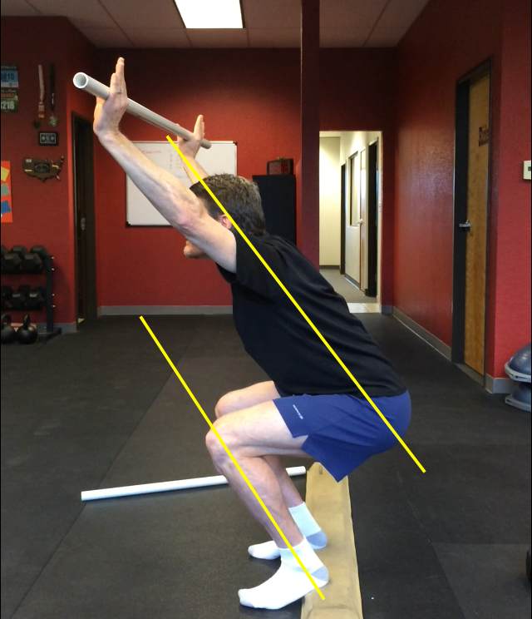
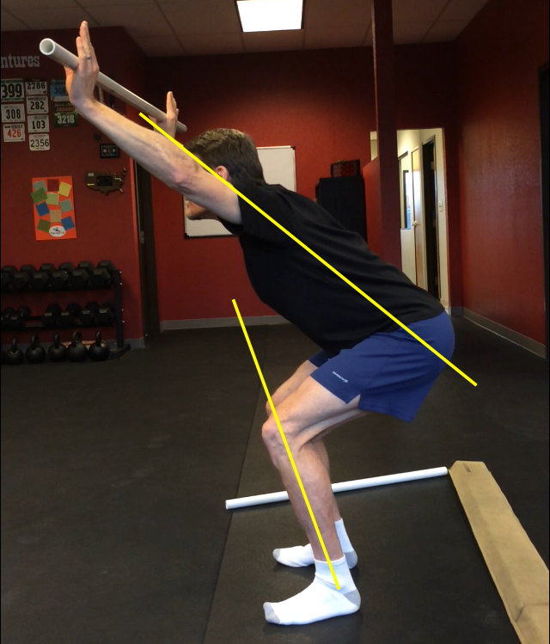
Injury
Non emergency - what’s the usual process? UrgentClinic? Phone Consult? Rx?
Early intervention and alternative solutions
POINT of pain is not the SOURCE of pain

Slide 9
Talk to us
What are you experiencing?
What impediments do you see?
What are your resources?

